Slide 1
Capstone Project HR Analytics - Employee retention Tarun N – F11678
Oct 2023

Slide 2

Problem statement : A company specializing in Big Data and Data Science endeavors to identify and select potential data science candidates from a pool of individuals who have successfully completed its training courses. The company's objective is to distinguish between candidates who are genuinely interested in joining the company after completing their training and those who are primarily seeking new employment opportunities. This differentiation is crucial for several reasons, including cost and time optimization, course planning, and effective candidate categorization.

Slide 3
Architectural flow diagram
01

Slide 4
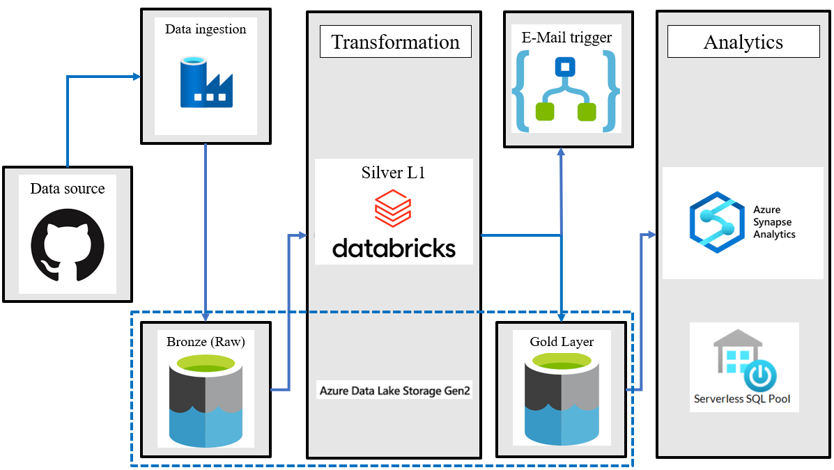

Slide 5
Process Flowchart
Data source
Transformation
Analytics
The raw CSV file is stored in the Git repository along with the documents related to the capstone project
The raw data present in the bronze layer is read by a databricks notebook activity using the azure data factory pipeline
Finally, the transformed data present in the gold layer is read as a view using serverless synapse SQL pool to gather insights for dashboards
E-Mail trigger
Data ingestion
The raw data stored in the Git repo is read by the using the copytool activity present in the azure data factory and written to the Bronze layer
Once the transformation logic is complete, the transformed data is written to the gold layer and an email is triggered with a success message using the web activity and logic apps in azure data factory

Slide 6


Data ingestion
02

Slide 7
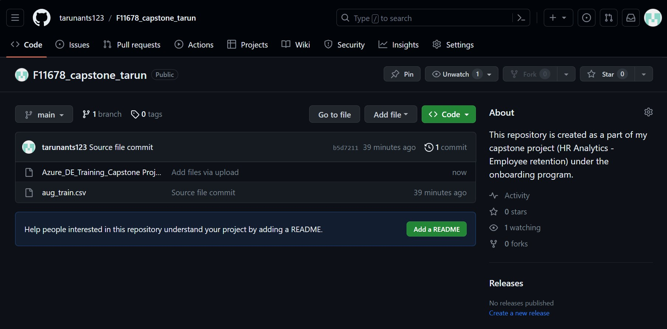
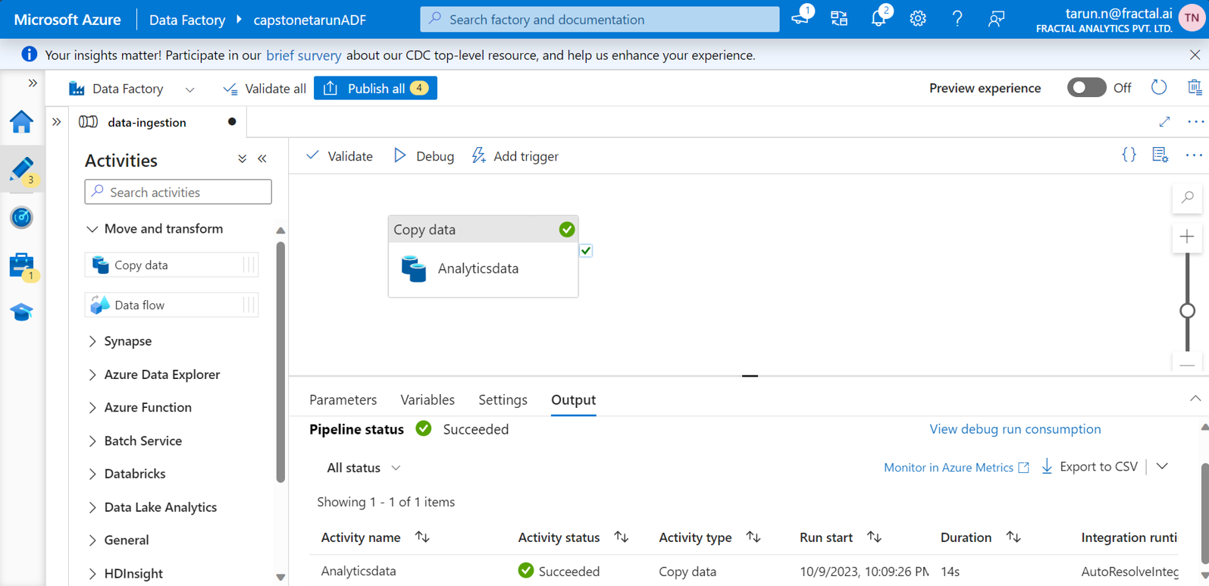
Data ingestion
Created a GitHub repository, the data source (csv file) and all the documents of project were added to it.
The Raw data is read from the git repository using the copytool activity in ADF.
The GitHub account is configured to employ token-based authentication with an anonymous authentication type, utilizing the repository's path as the base URL.
+8.7%
+10.3%

Slide 8
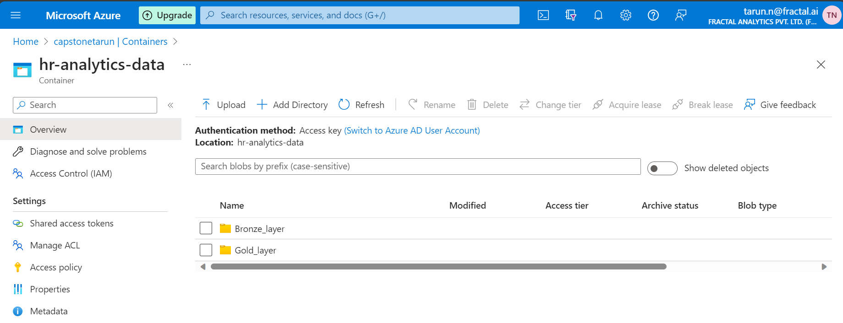
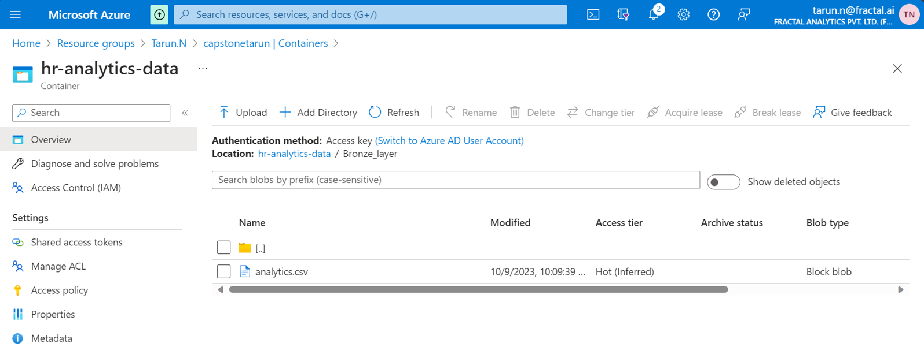
Data ingestion
According the medallion architecture the raw data is placed in the Bronze layer in ADLS storage.
The raw data is written from the github repo to the bronze layer using the copytool activity in ADF as analytics.csv
Medallion architecture organizes data in three different layers such as bronze, silver and gold
+8.7%
+10.3%

Slide 9
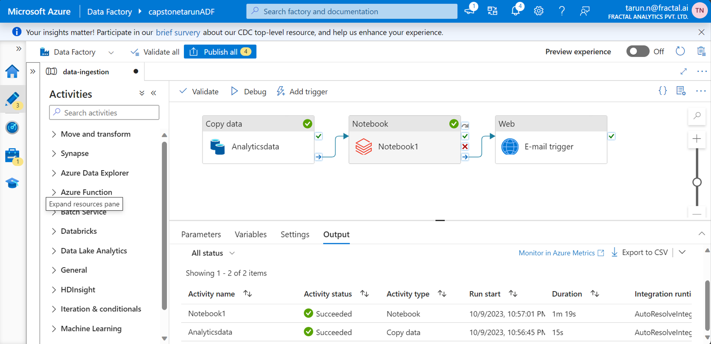
Creating a notebook activity, the notebook activity will read the raw data (analytics.csv) from the Bronze layer.
Here we can observe that the pipeline is successful, and the raw data is read by the notebook activity
67%

Slide 10
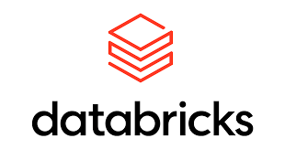
Azure Databricks configuration
03

Slide 11
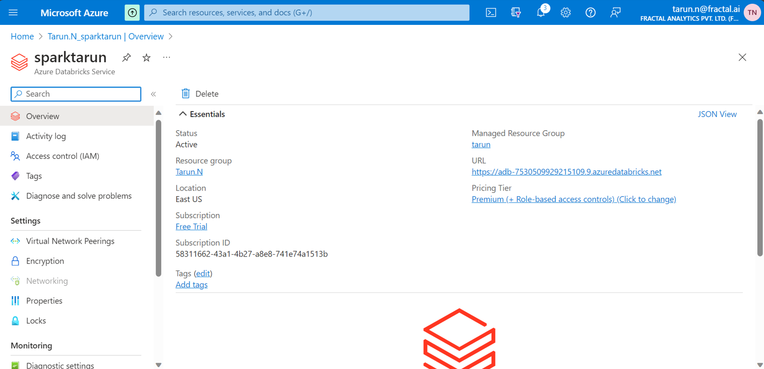
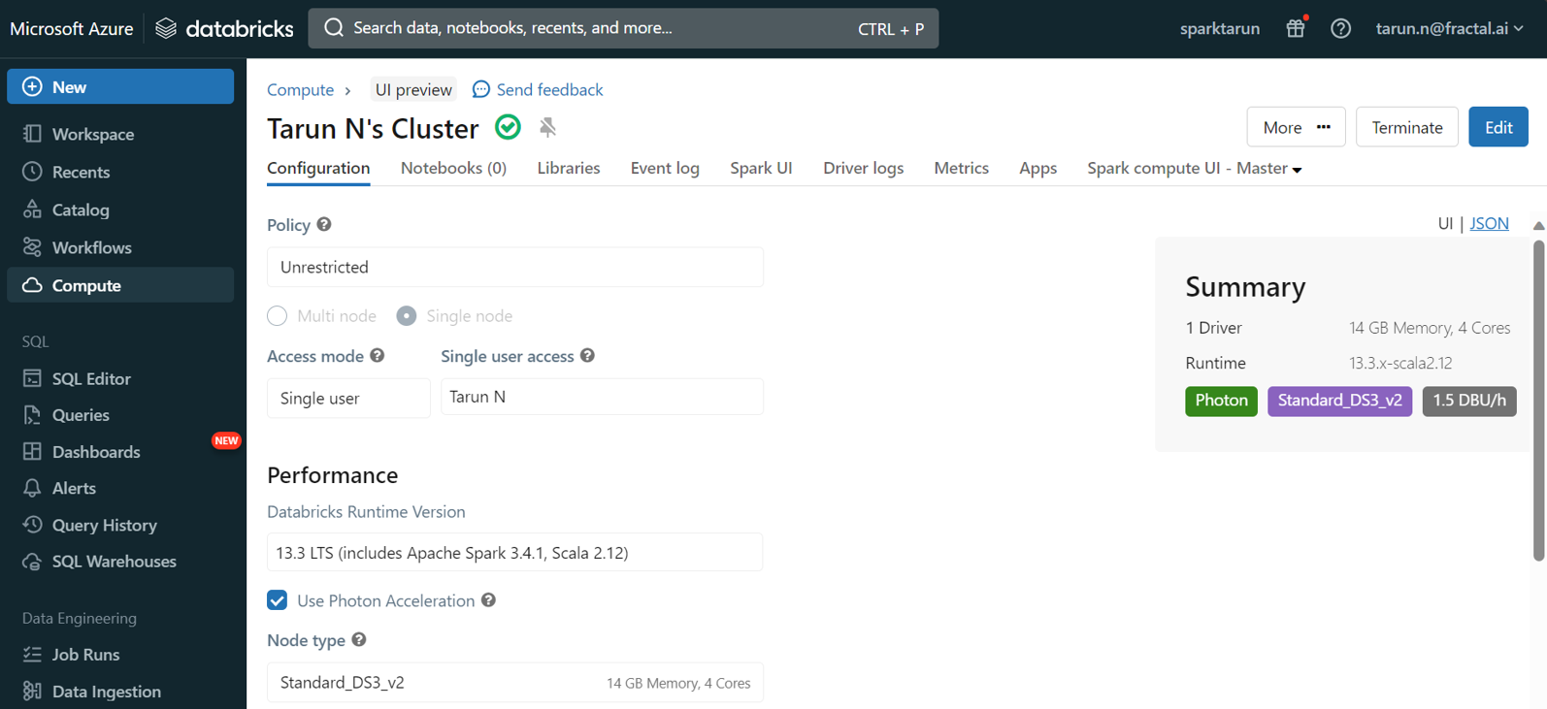
Azure Databricks configuration
Firstly, an azure databricks service called sparktarun has been created with the premium pricing tier.
A single node cluster using 13.3LTS and a standard_DS3_v2 node was deployed.
Azure Databricks is one of the most expensive service in azure hence it’s important to deprovision it whenever not needed to minimize costs

Slide 12
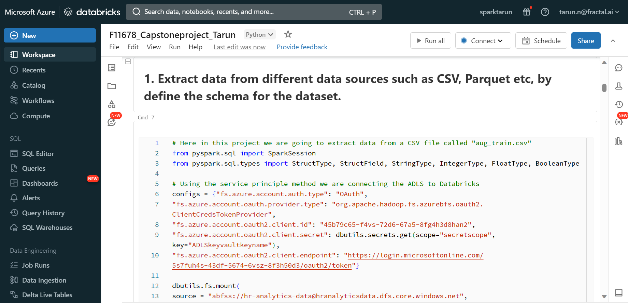
Connecting ADLS gen2 to Databricks using the Service principle method
Azure App Registration and Client Secret:
Create a new App Registration in Azure Portal.
Generate and copy a client secret for this App Registration.
Store the client secret securely as a secret in Azure Key Vault.
Retrieve Application and Client IDs:
Databricks Secret Scope:
From the registered Azure App, copy the Application ID and Client ID.
Save these IDs in a secure location, such as a notepad or a secure document.
Create a secret scope in Databricks.
Link this secret scope to the secrets stored in Azure Key Vault for secure access.

Slide 13
Transformation logic
04

Slide 14
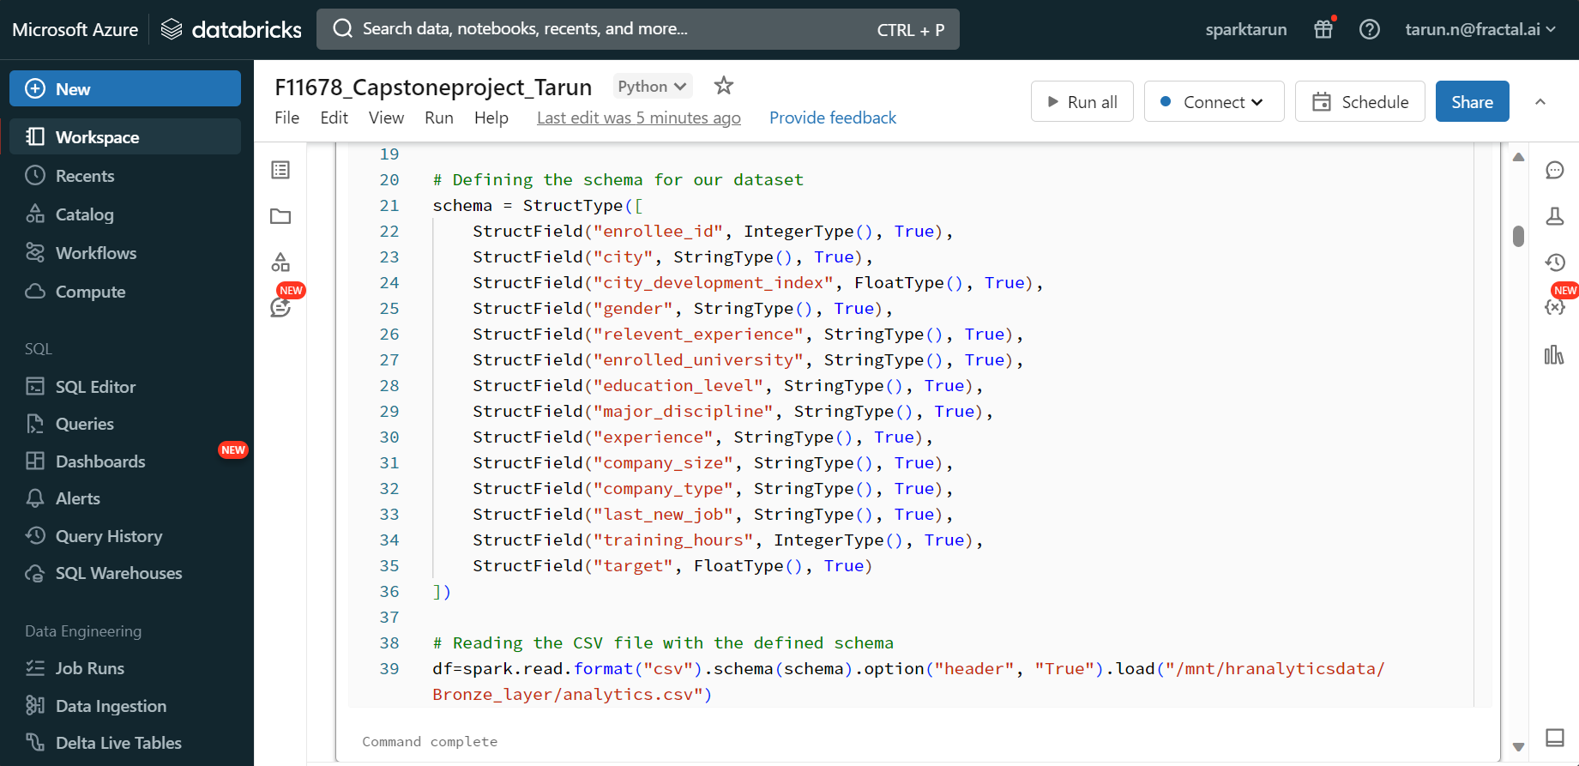
1. Extract data from different data sources such as CSV, Parquet etc, by define the schema for the dataset

Slide 15
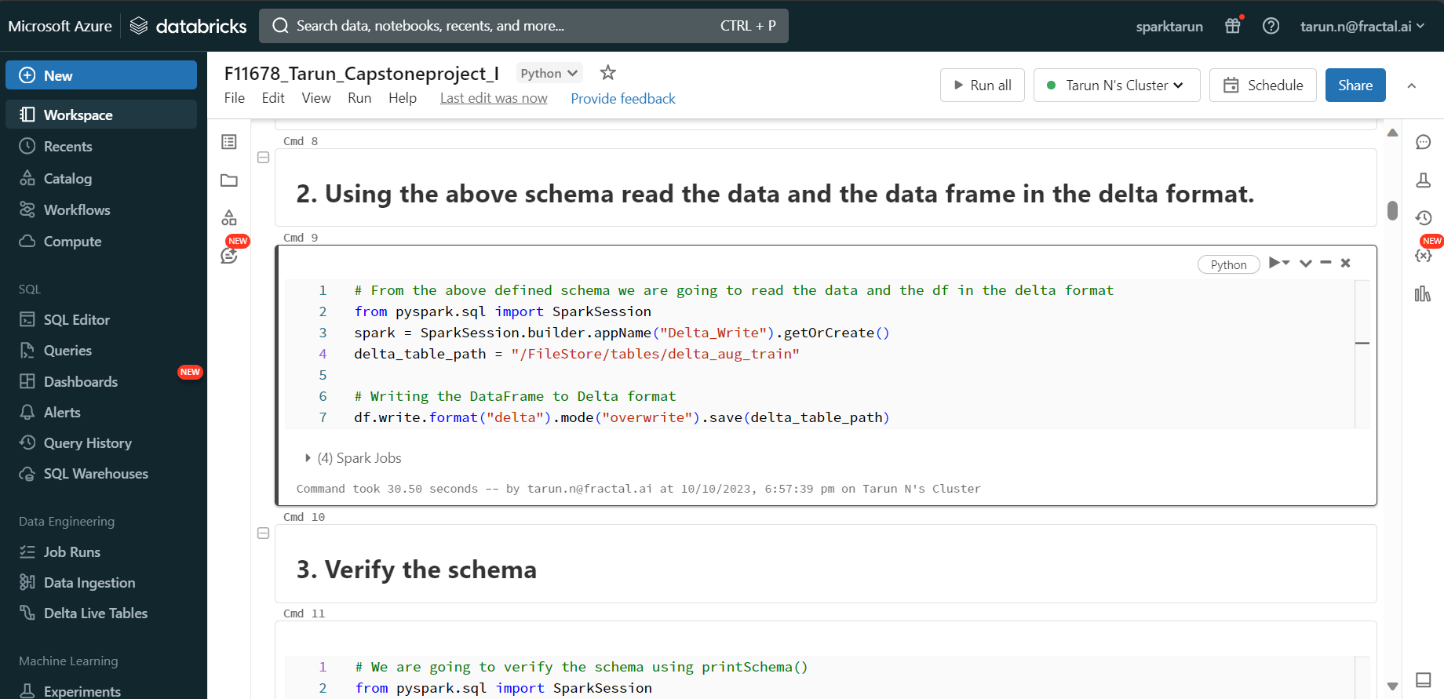
2. Using the above schema read the data and the data frame in the delta format

Slide 16
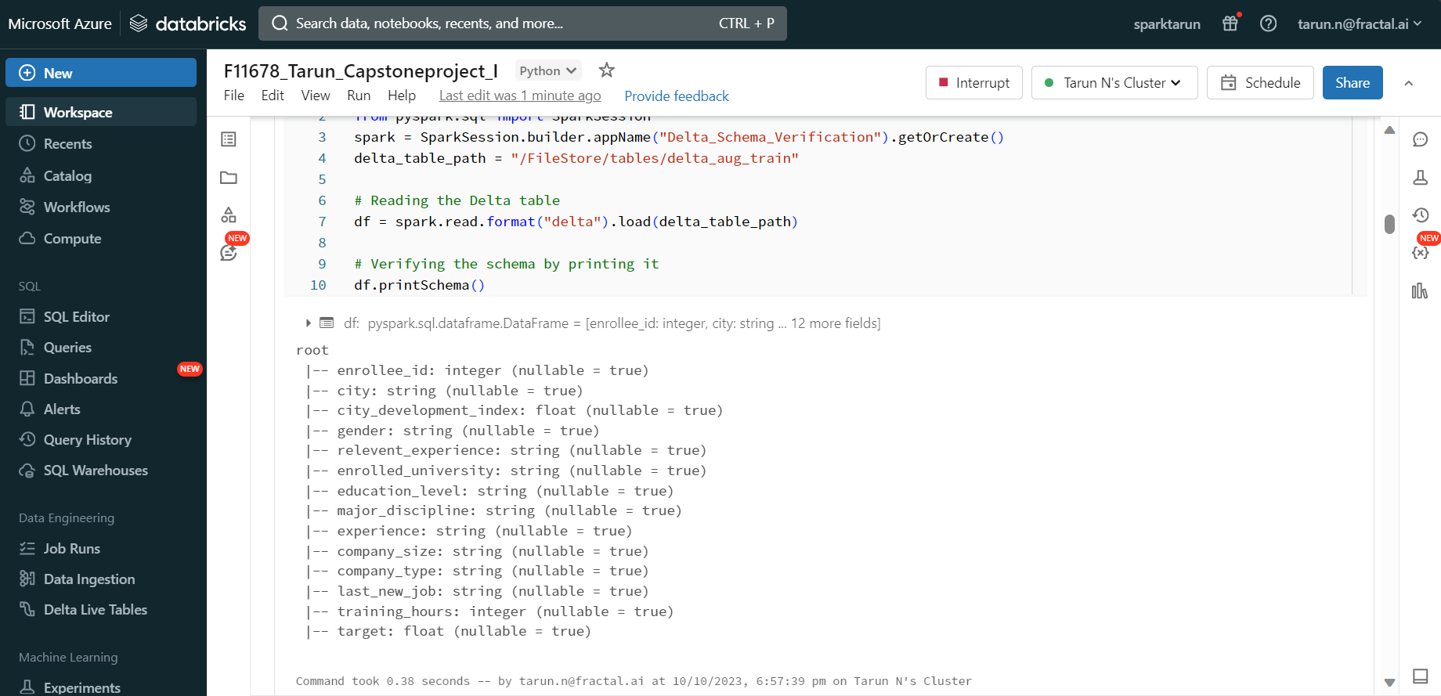
3. Verify the schema

Slide 17
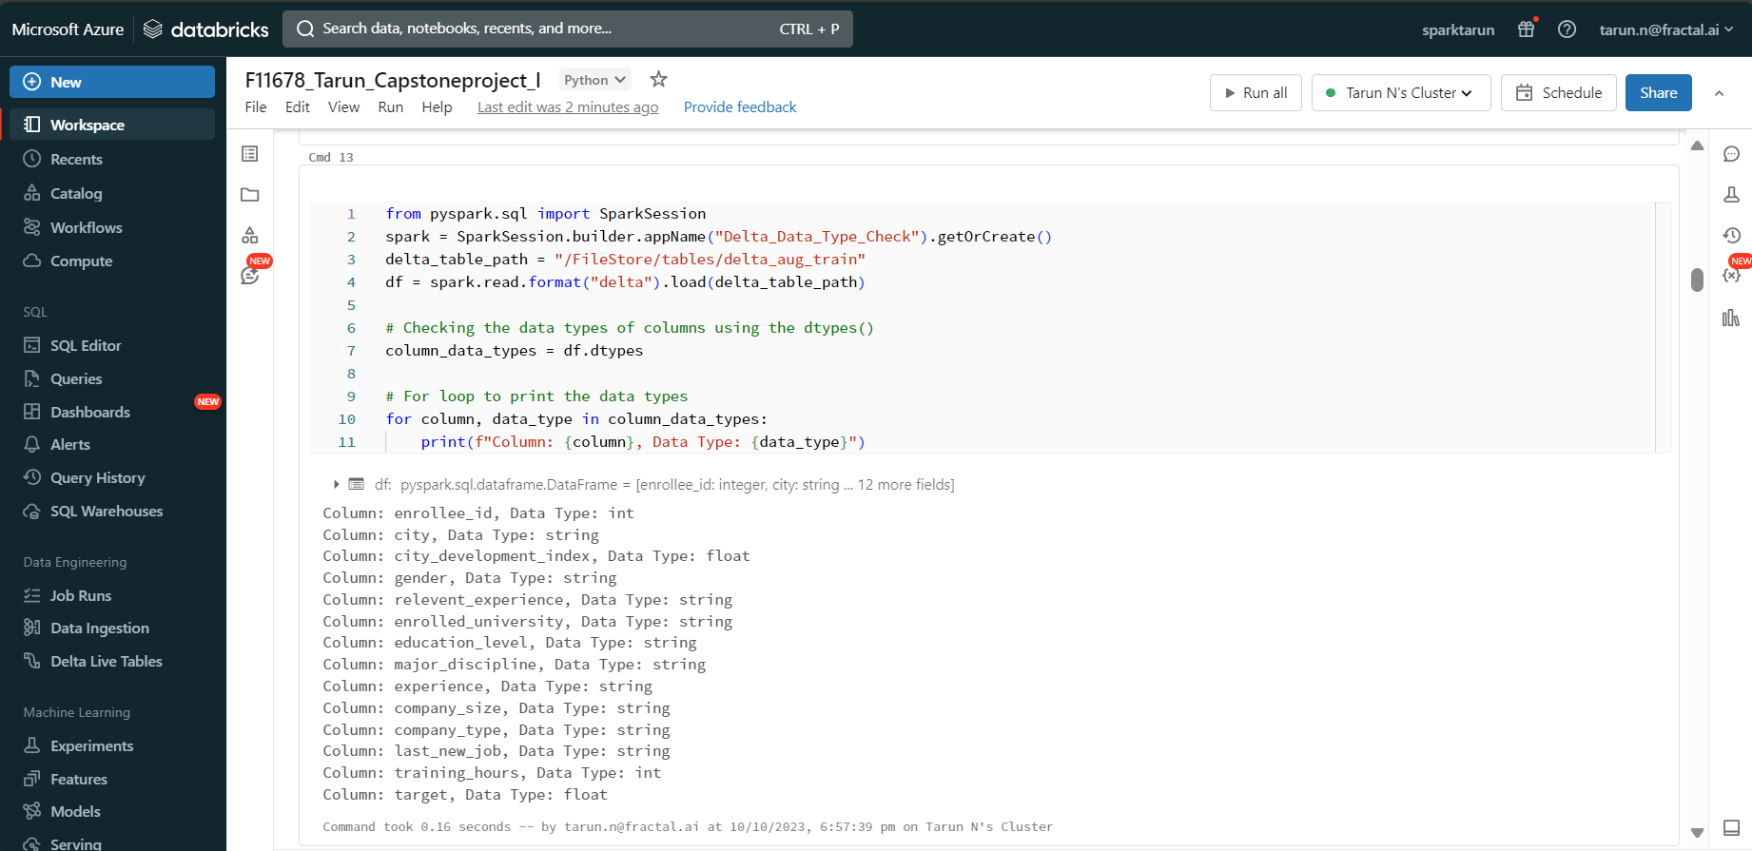
4. Check the datatypes

Slide 18
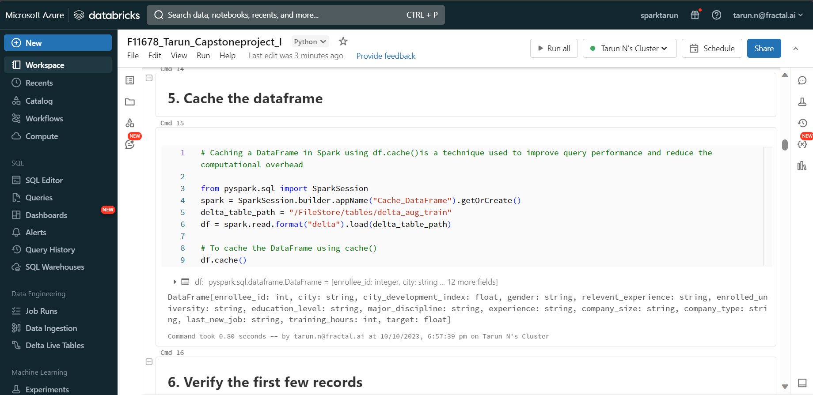
5. Cache the dataframe

Slide 19
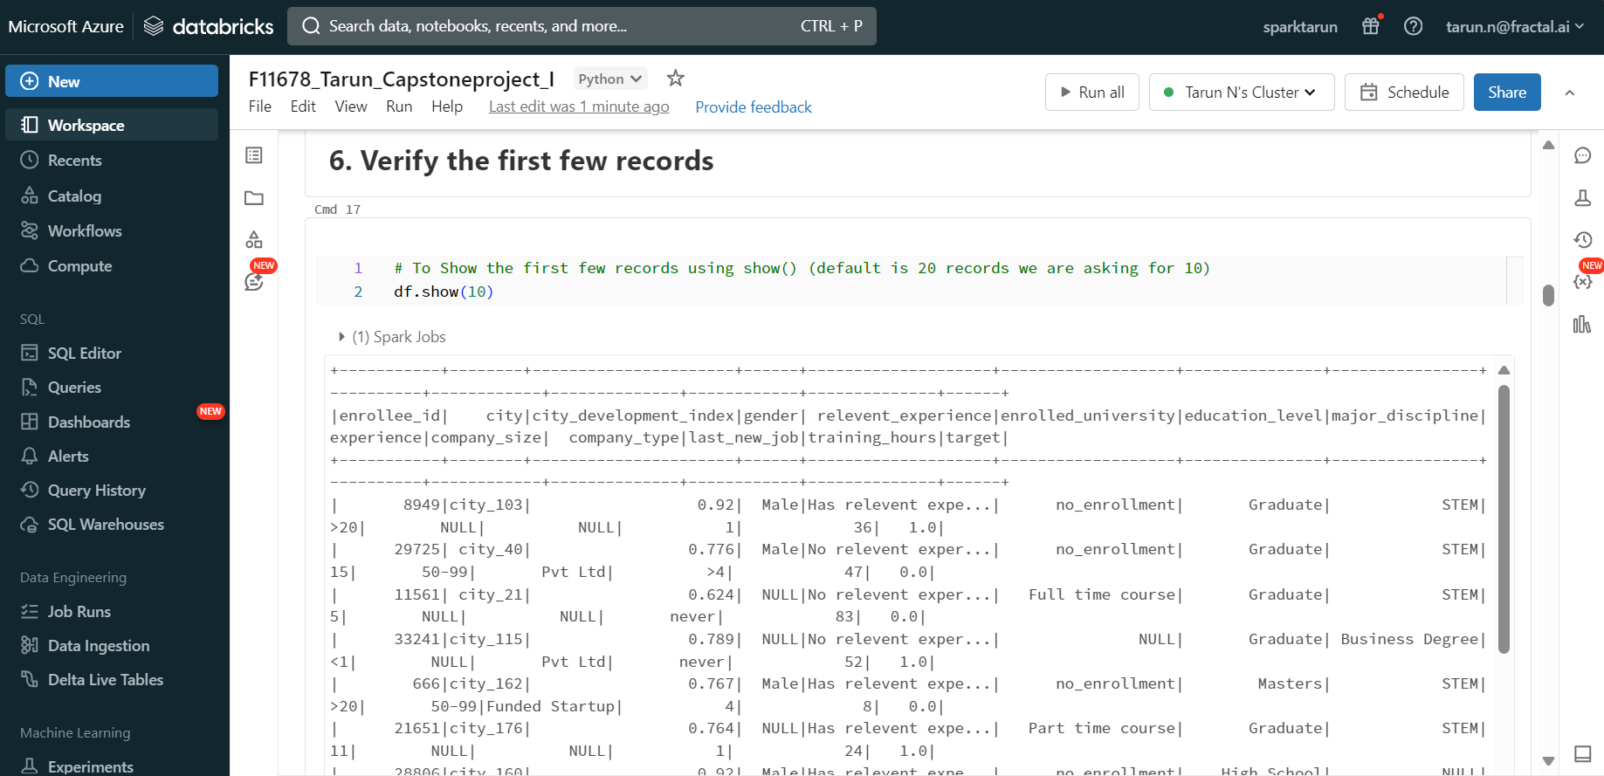
6. Verify the first few records

Slide 20
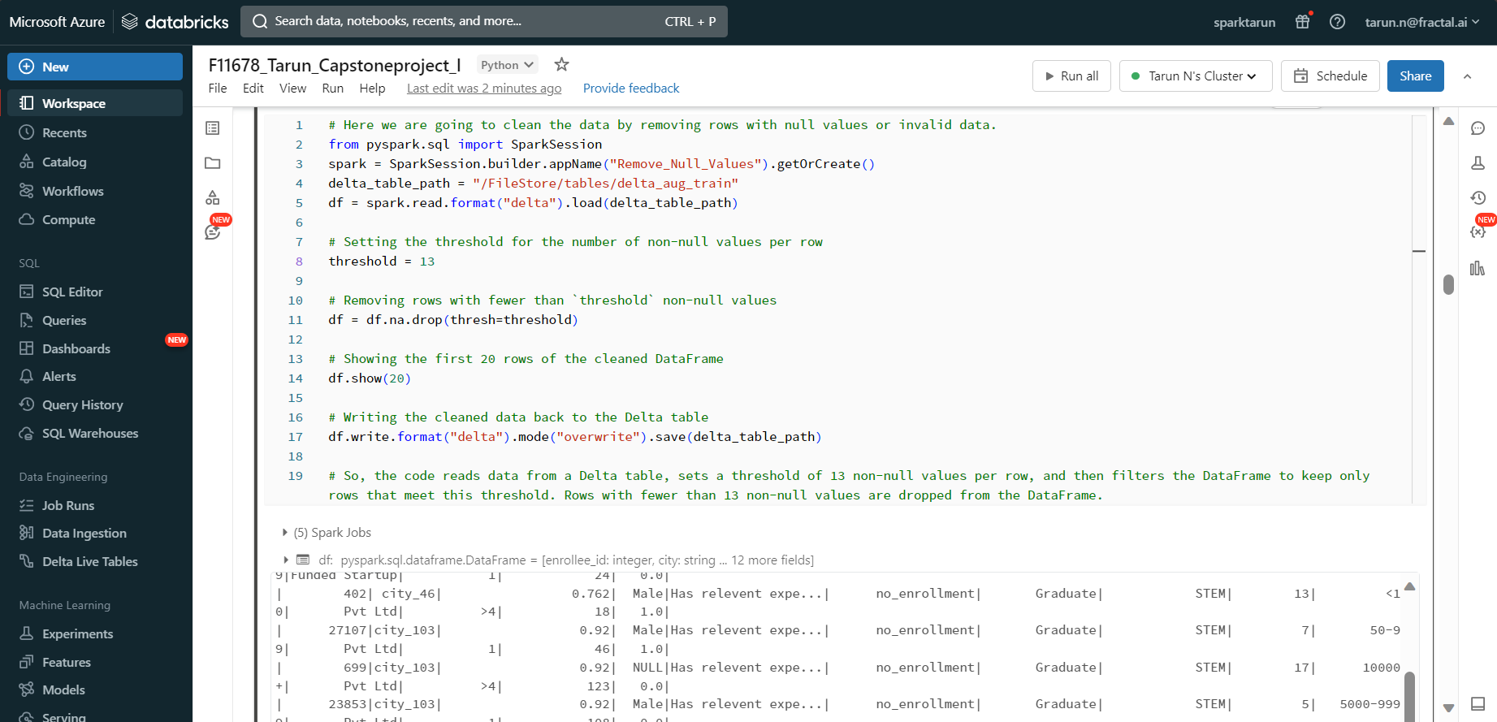
7. Clean the data by removing duplicates, null values, and invalid data

Slide 21
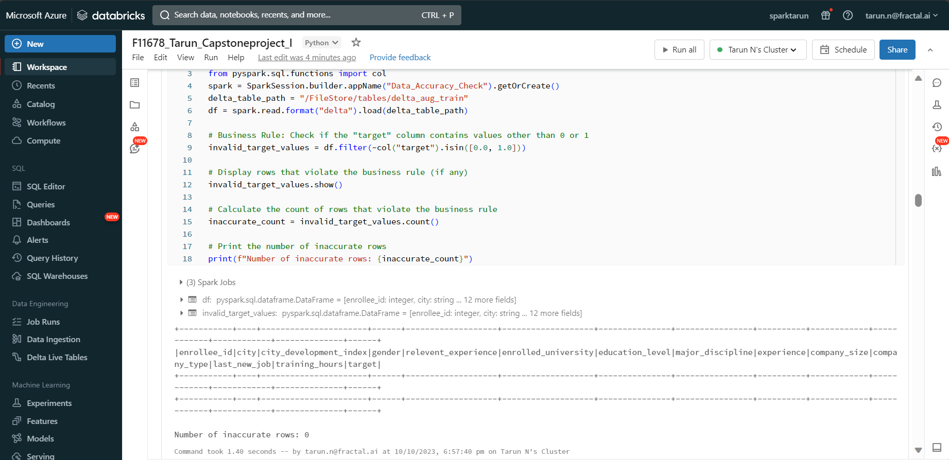
8. Check for data accuracy by validating the data against the business rules

Slide 22
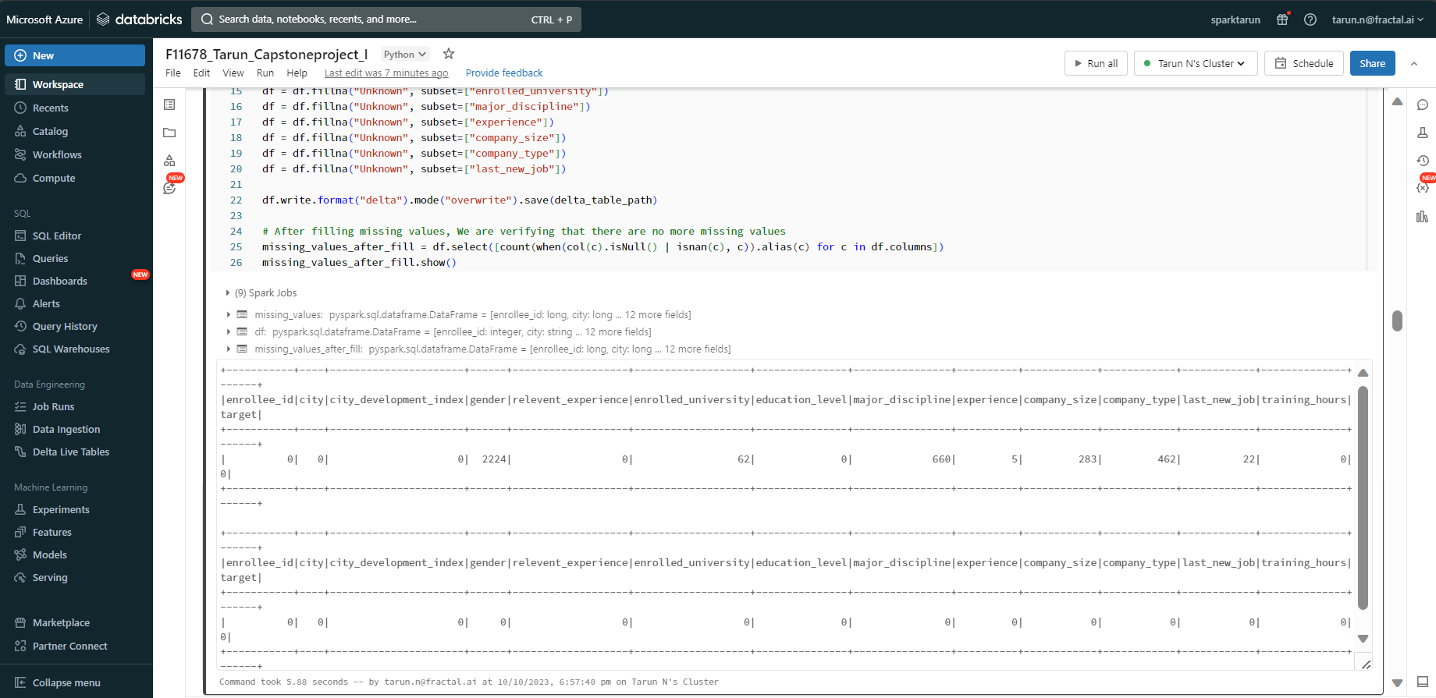
9. Ensure the data is complete by checking for missing values and filling them with appropriate values (output)

Slide 23
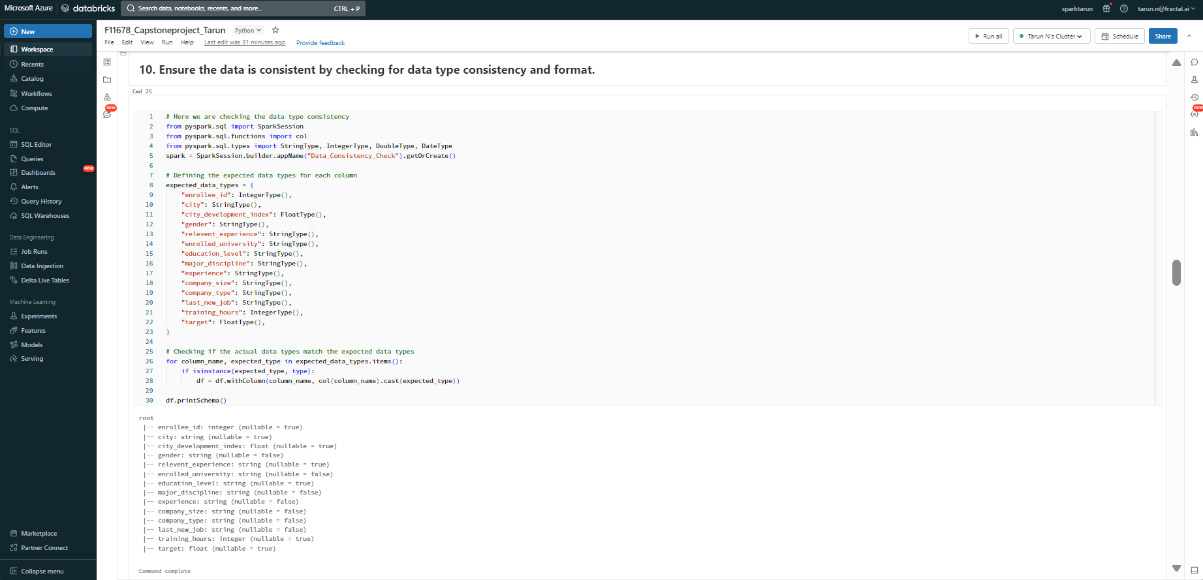
10. Ensure the data is consistent by checking for data type consistency and format

Slide 24
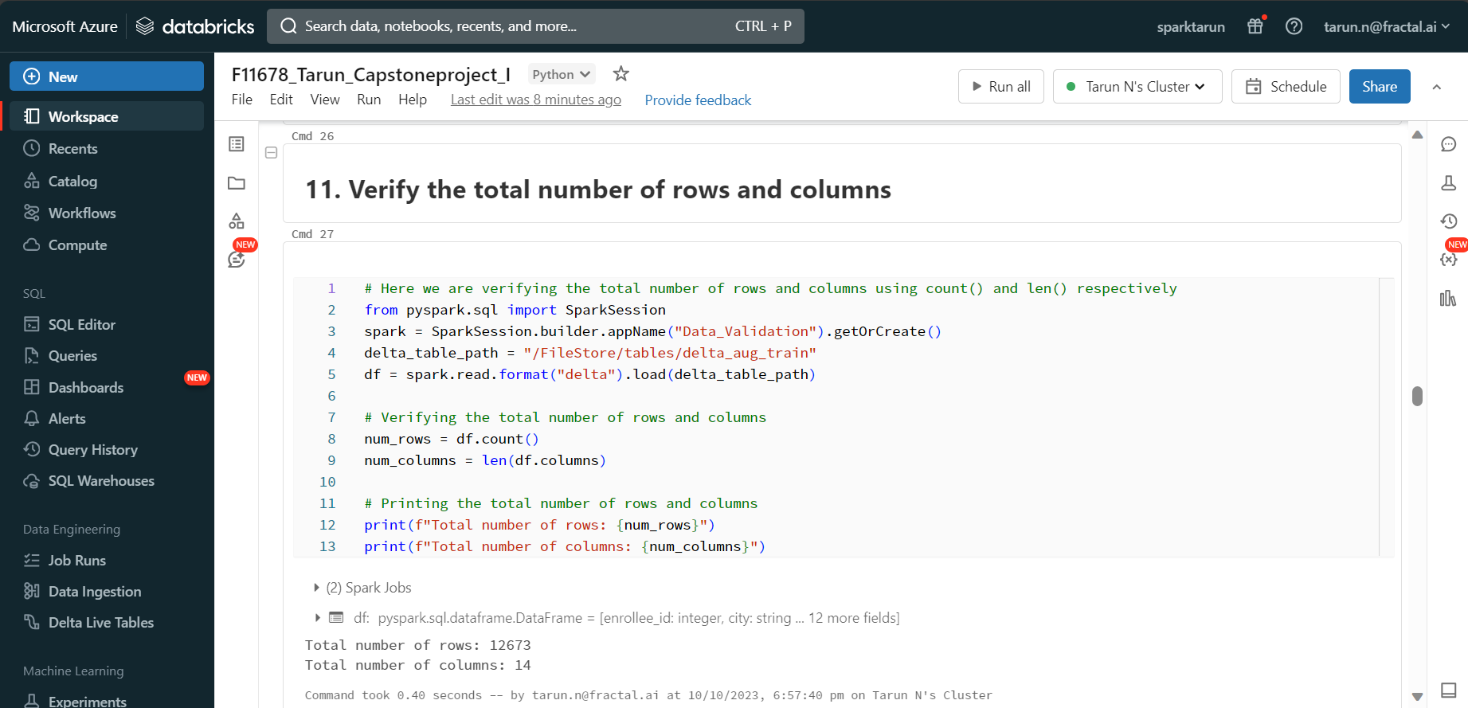
11. Verify the total number of rows and columns

Slide 25
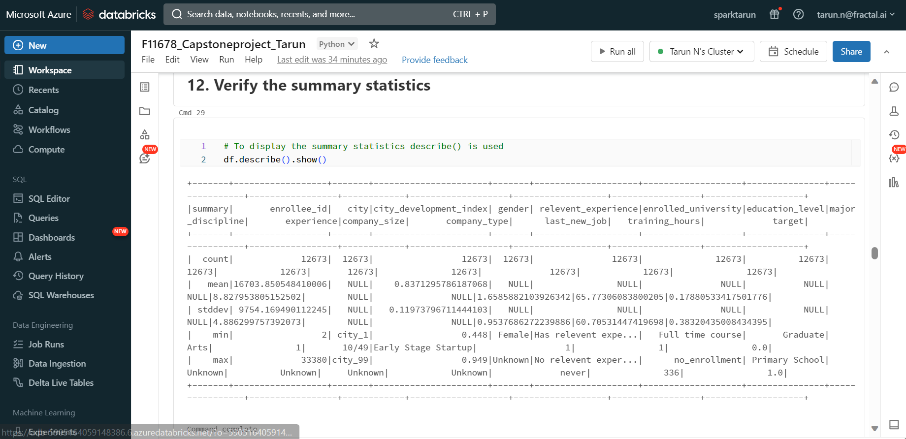
12. Verify the summary statistics

Slide 26
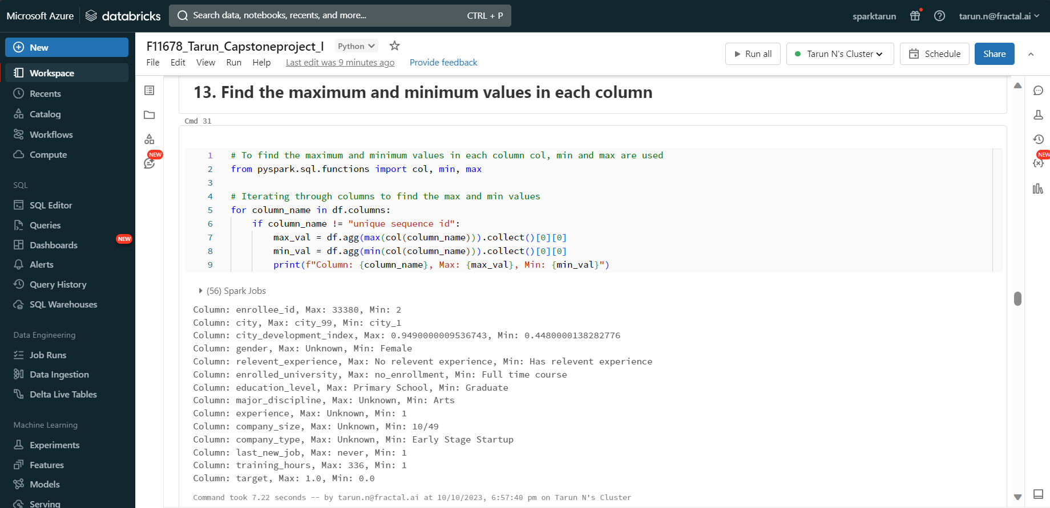
13. Find the maximum and minimum values in each column

Slide 27
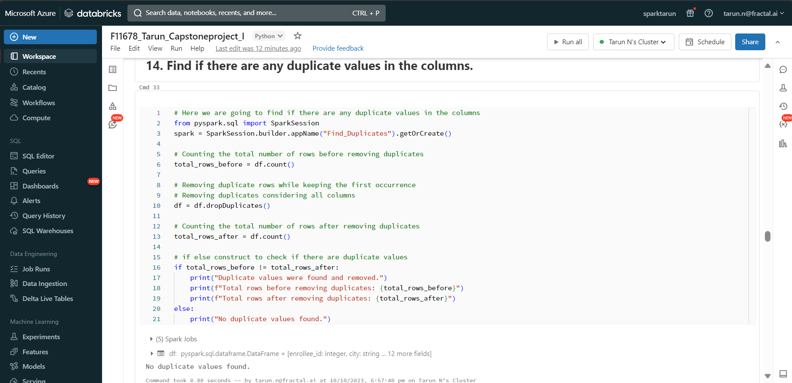
14. Find if there are any duplicate values in the columns

Slide 28
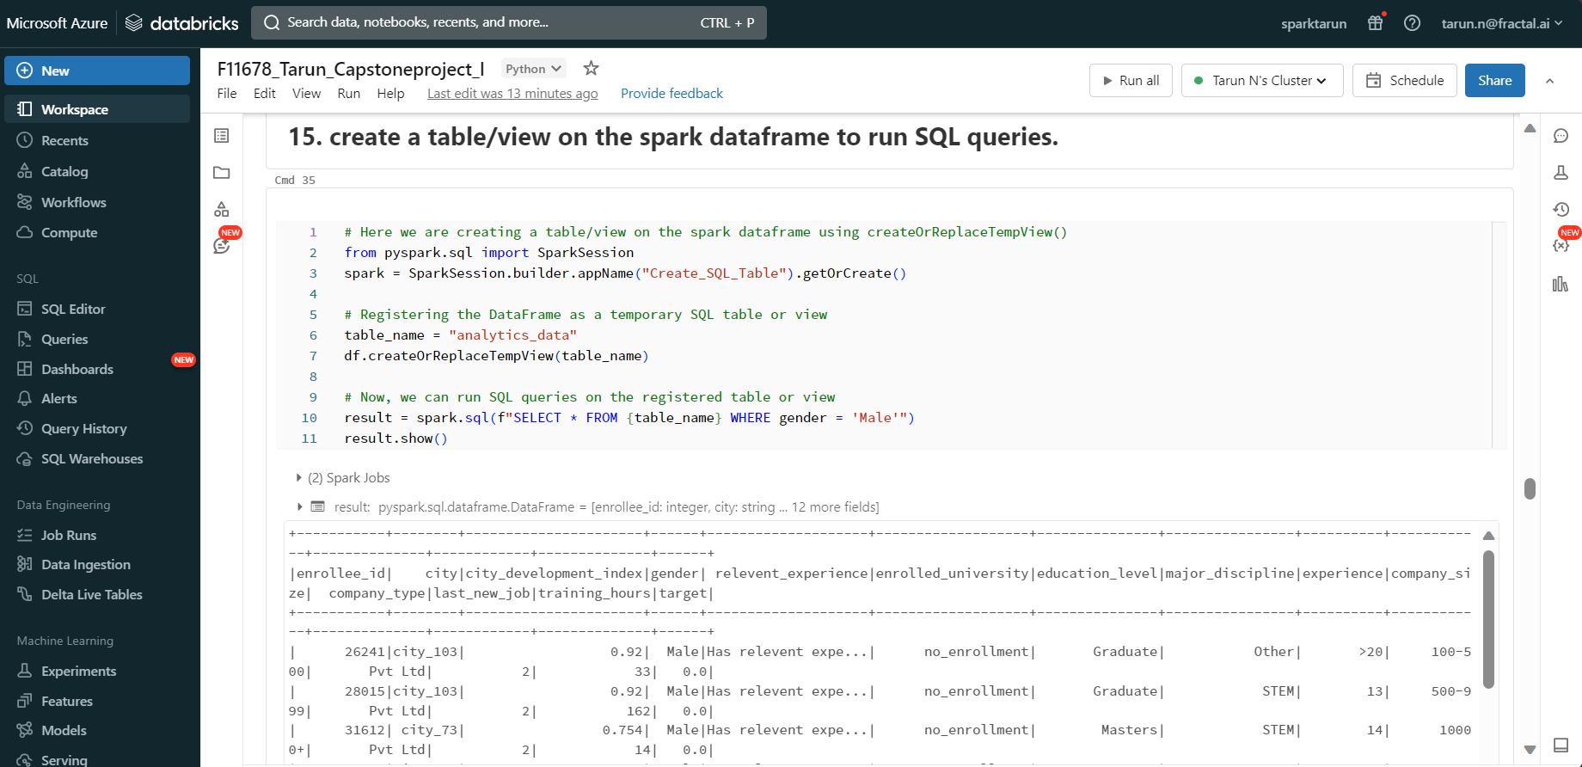
15. Create a table/view on the spark dataframe to run SQL queries

Slide 29
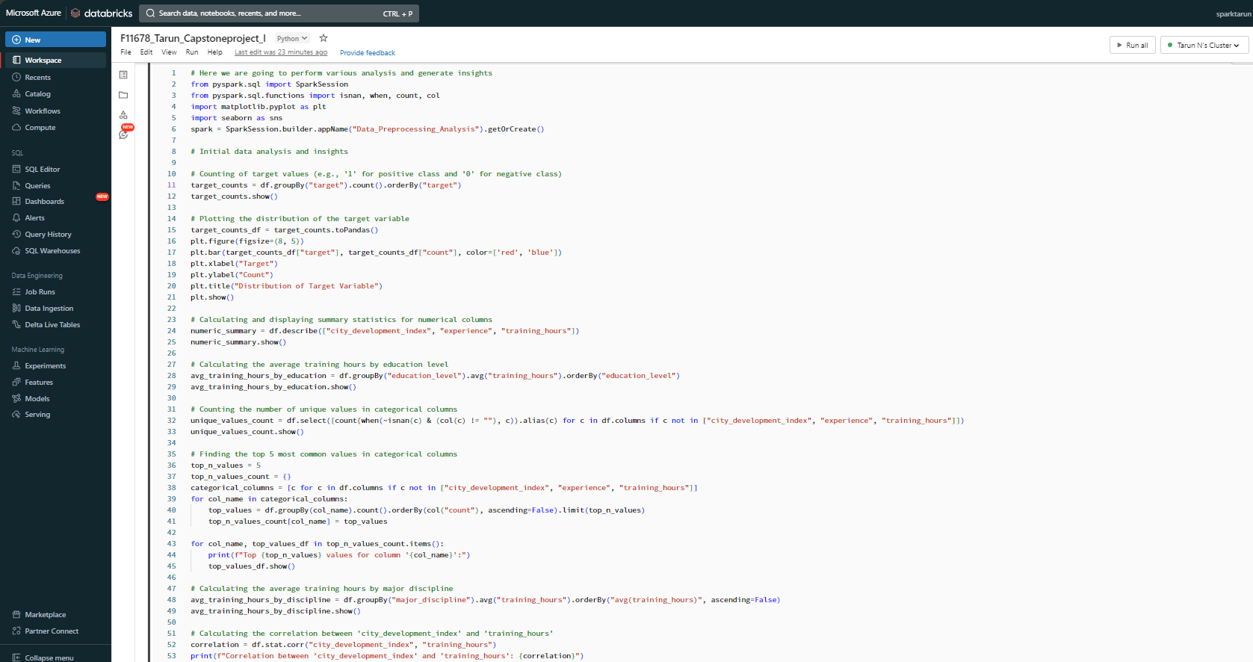
16. Complete the preprocessing steps by bringing any required analysis and give the insights you have identified.

Slide 30
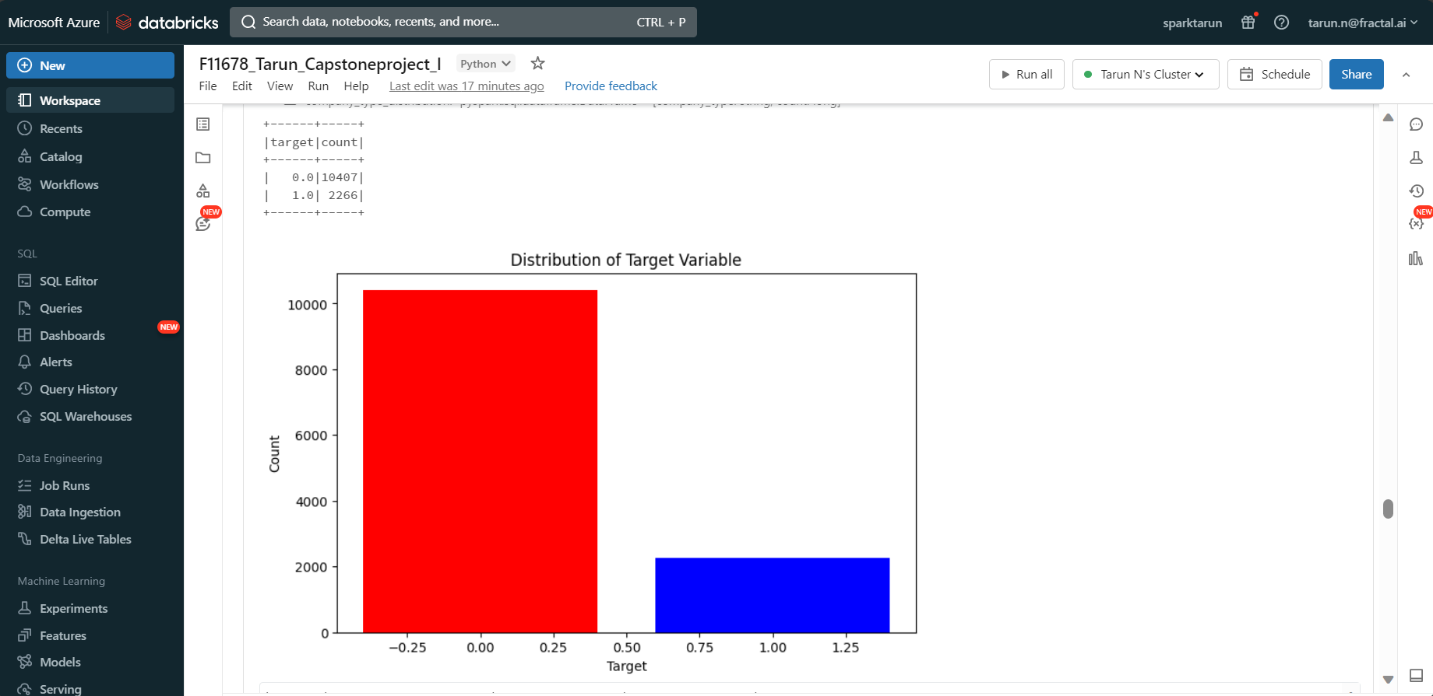
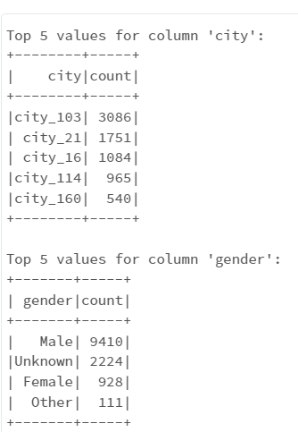
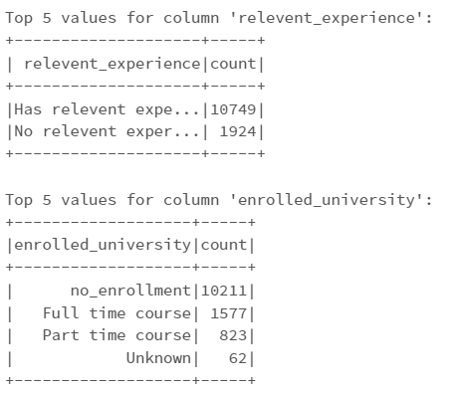
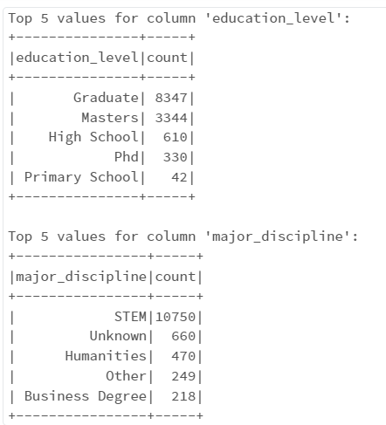
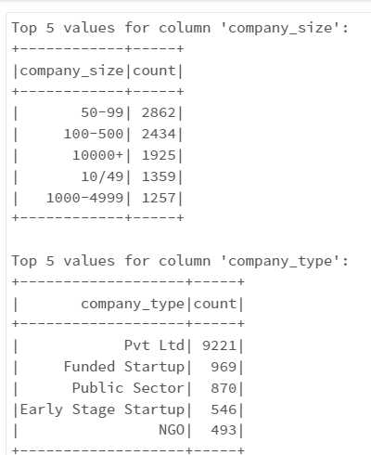
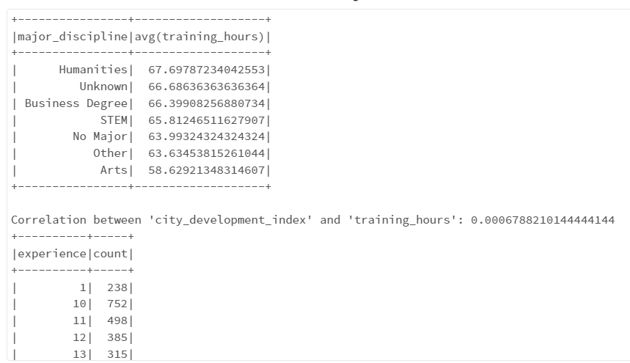
16. Complete the preprocessing steps by bringing any required analysis and give the insights you have identified.

Slide 31
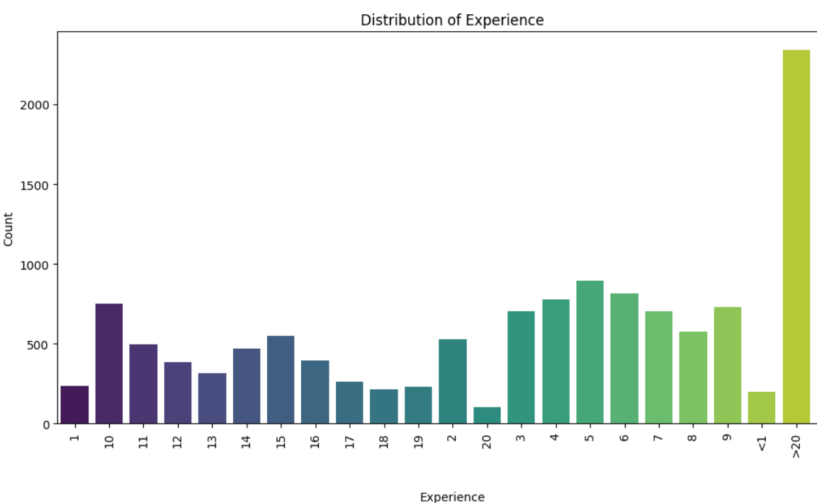
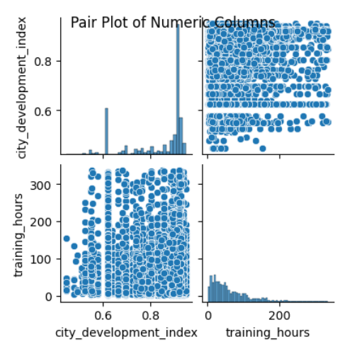
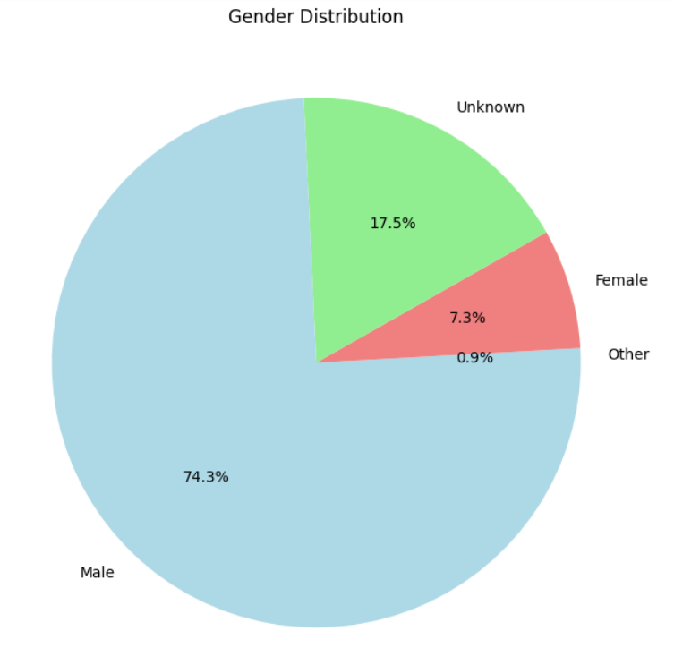
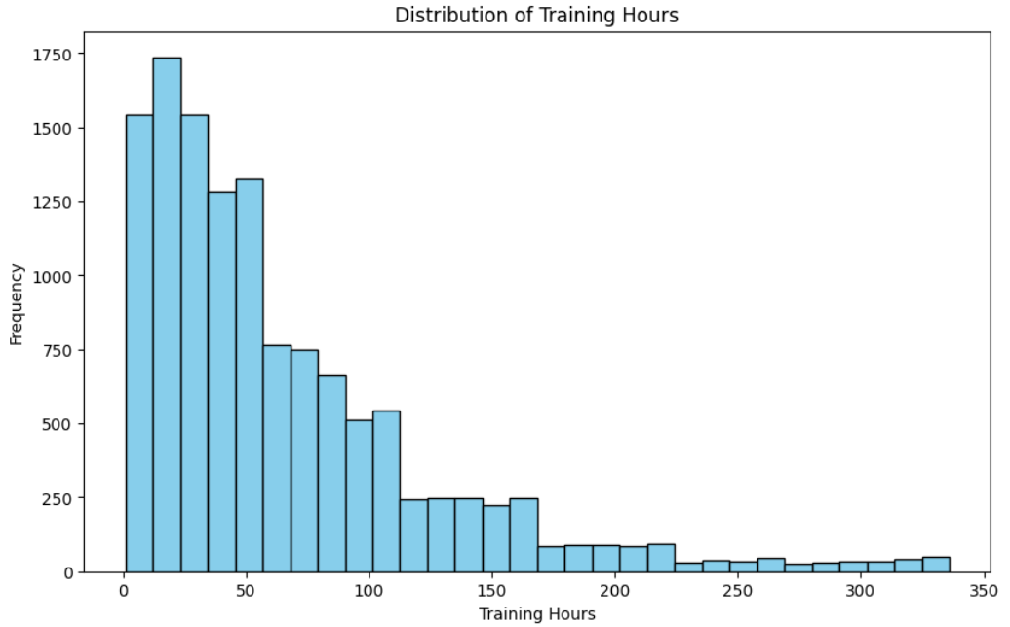
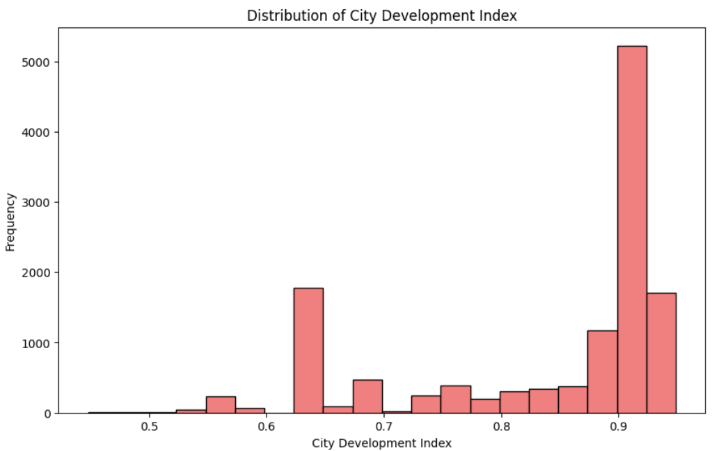
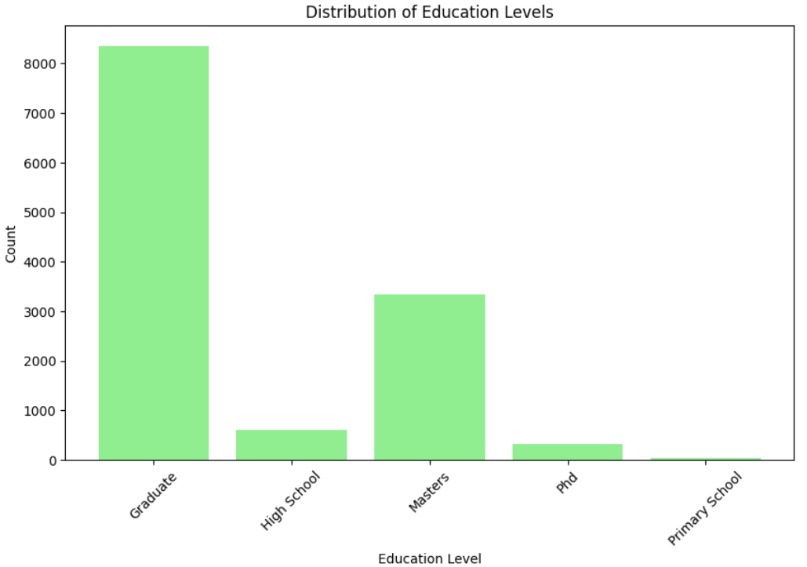
16. Complete the preprocessing steps by bringing any required analysis and give the insights you have identified.

Slide 32
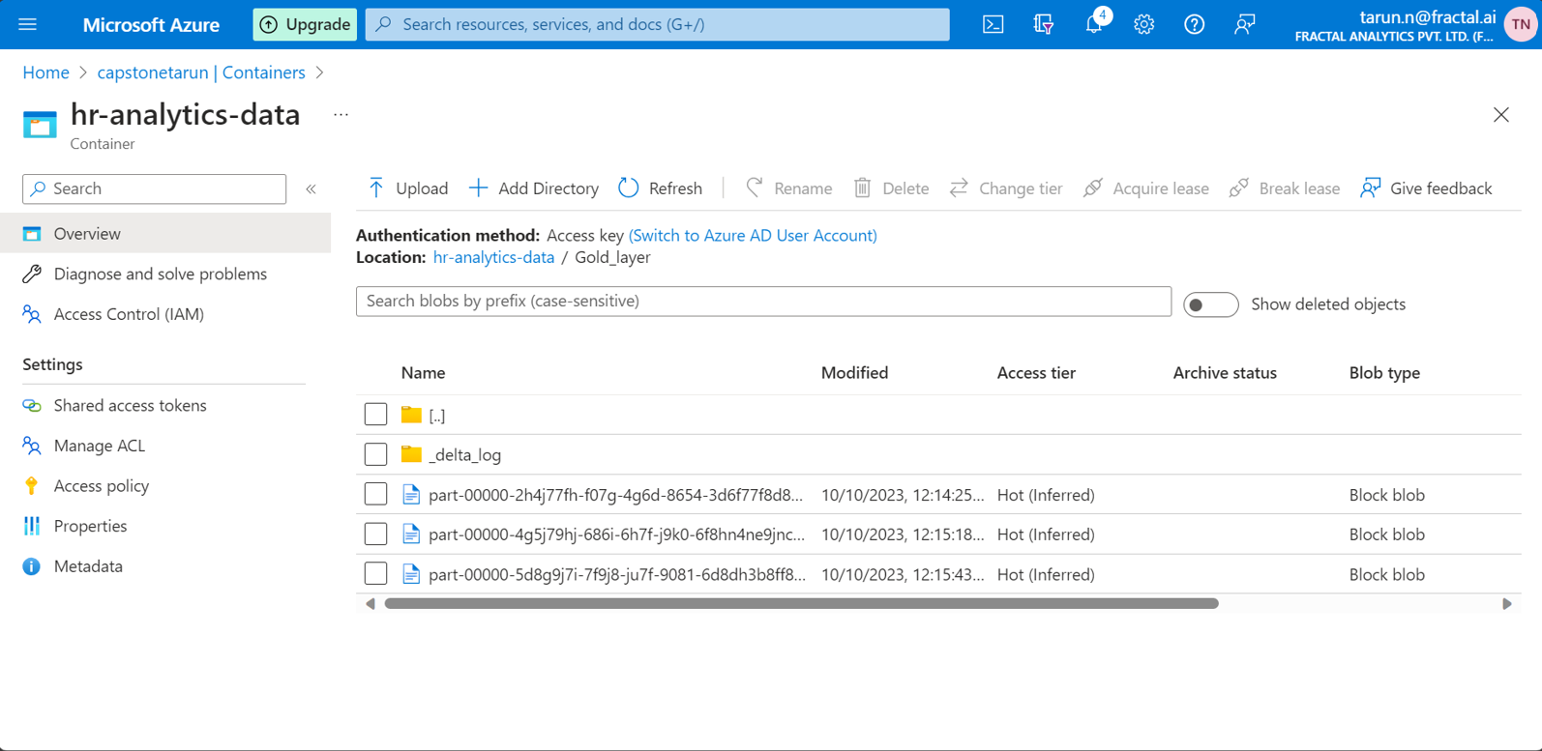
Once the transformations are complete in ADB then the transformed data is written to the gold layer.
We can observe that the data is written in the delta format in Gold_layer
67%

Slide 33
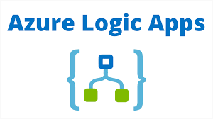
E-Mail trigger using ADF
05

Slide 34
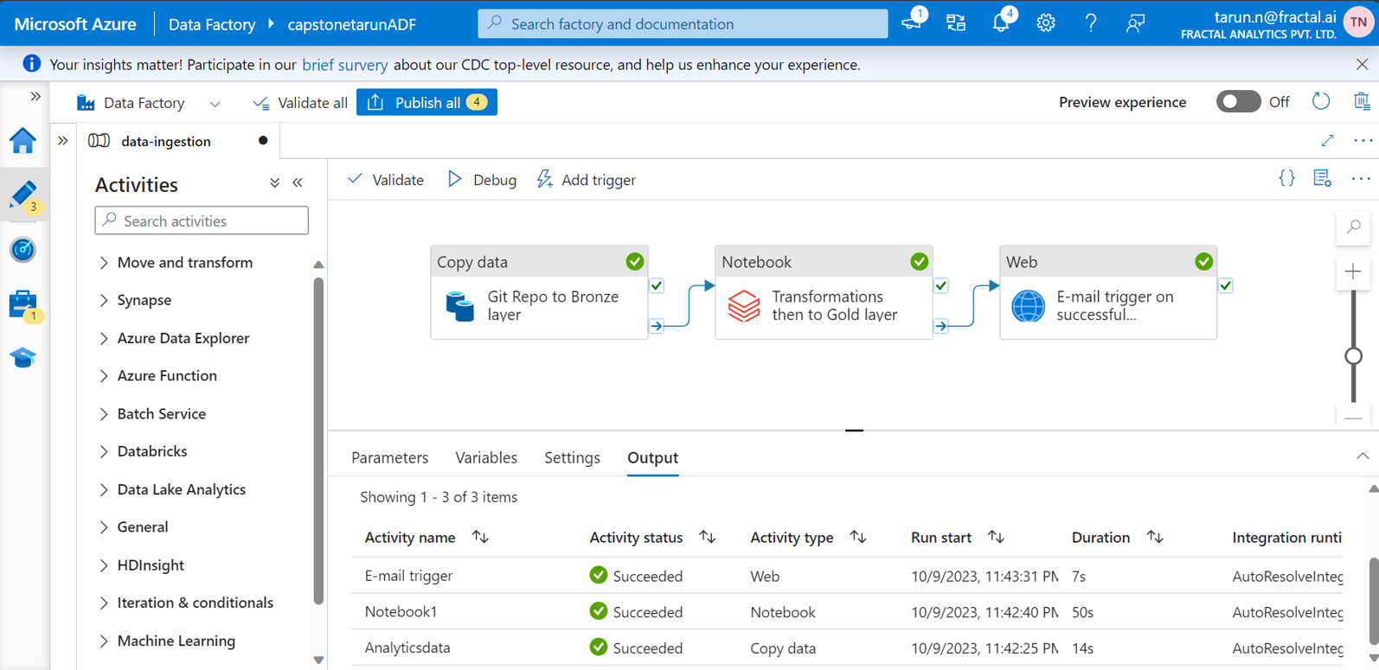
Once the transformations are complete in ADB then we design a pipeline in ADF to trigger a success email using web activity.
We can observe that all three stages of the pipeline are successful
67%

Slide 35
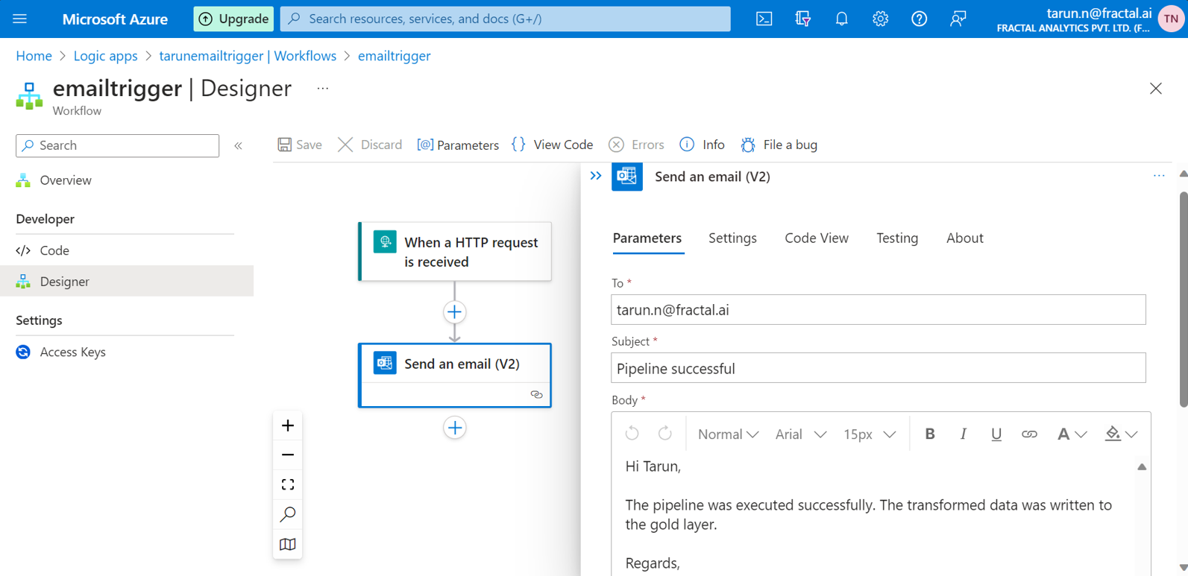
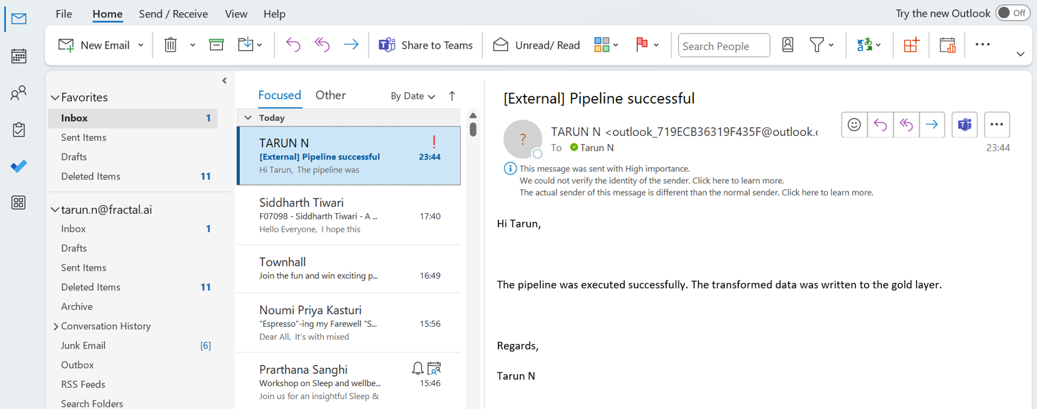
E-mail trigger
Once the pipeline is executed successfully an email should be triggered with a success message.
The email trigger is designed using the logic apps and workflow designer.
E-mail trigger is particularly useful in pipelines to get regular updates on the working of the pipelines hence improving reliability.

Slide 36
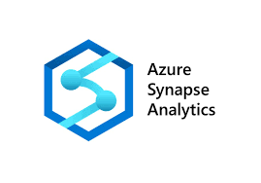
Analytics using synapse SQL pools
06

Slide 37
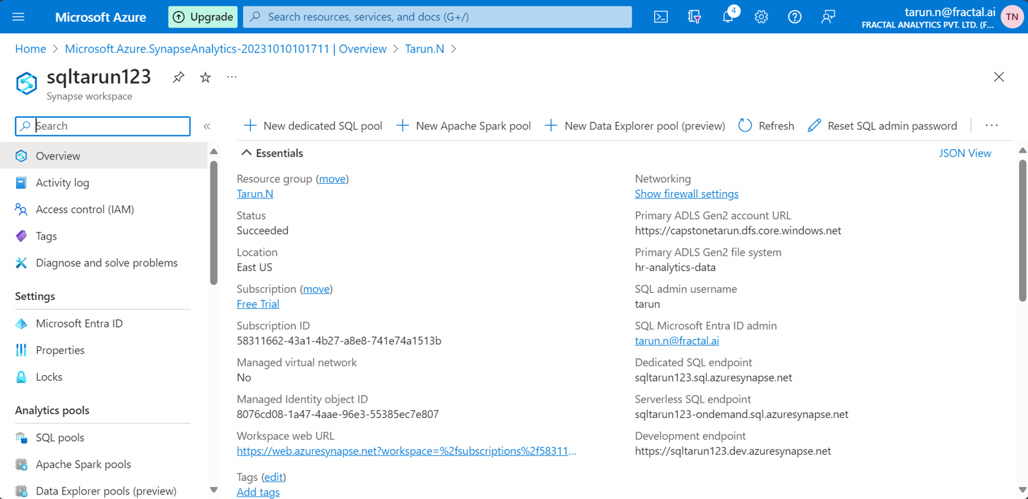
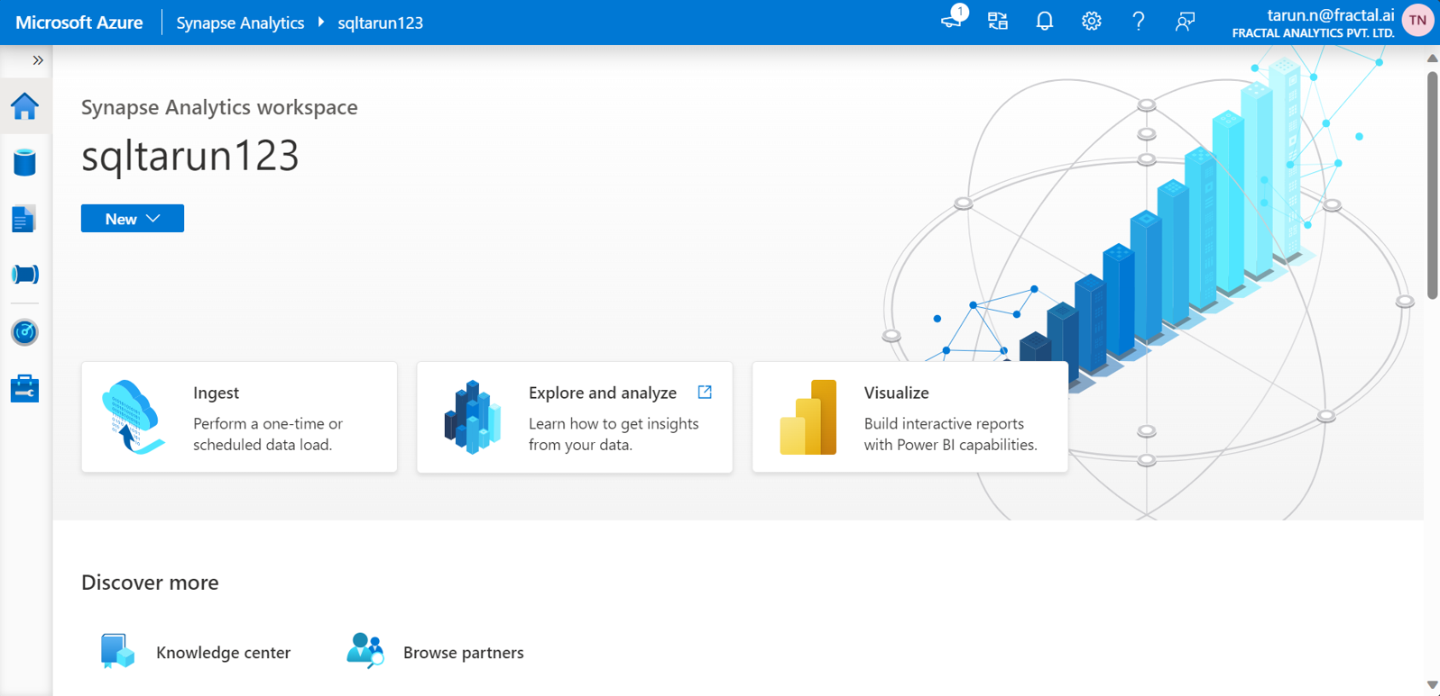
Analytics
Firstly, a synapse workplace called sqltarun123 was created to use the services.
Synapse studio is launched to perform the analysis on the transformed data.
During the creation of the synapse workspace we will be asked to connect to an existing storage account to provide access to the containers

Slide 38
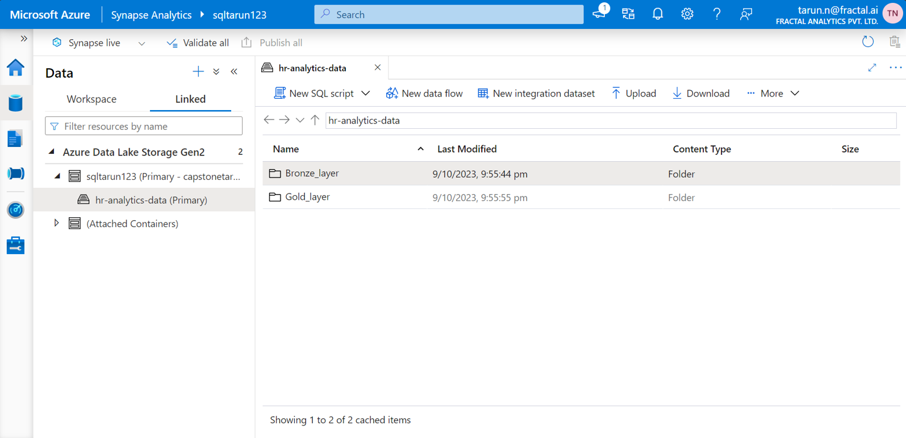
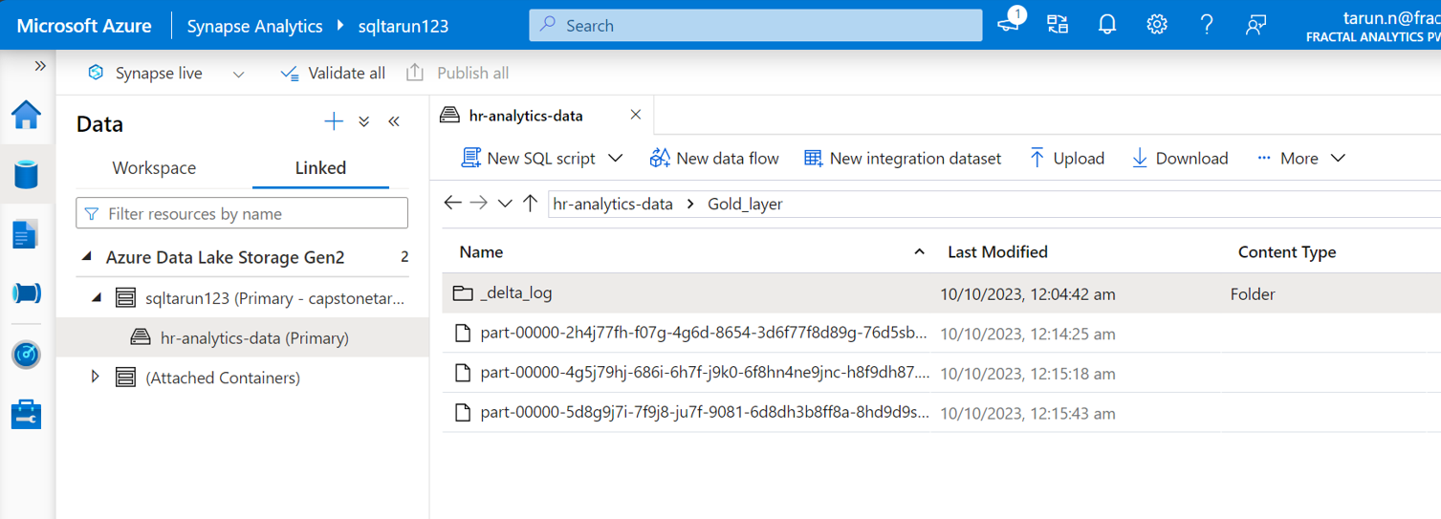
Analytics
Here, we can find our storage account under the linked services.
The gold layer consists of the transformed data from the ADB in the delta format.
The contents of the storage accounts where the raw data and transformed data were stored are linked to the synapse workspace

Slide 39
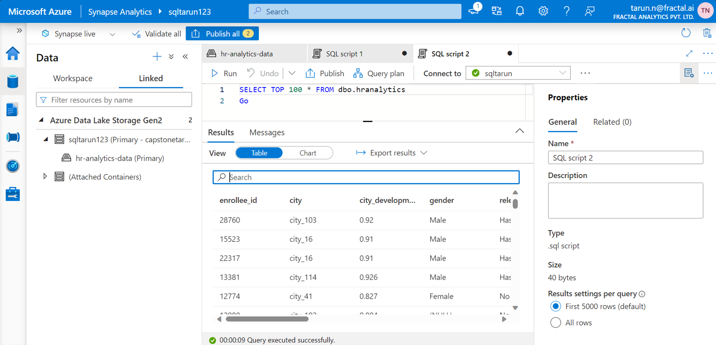
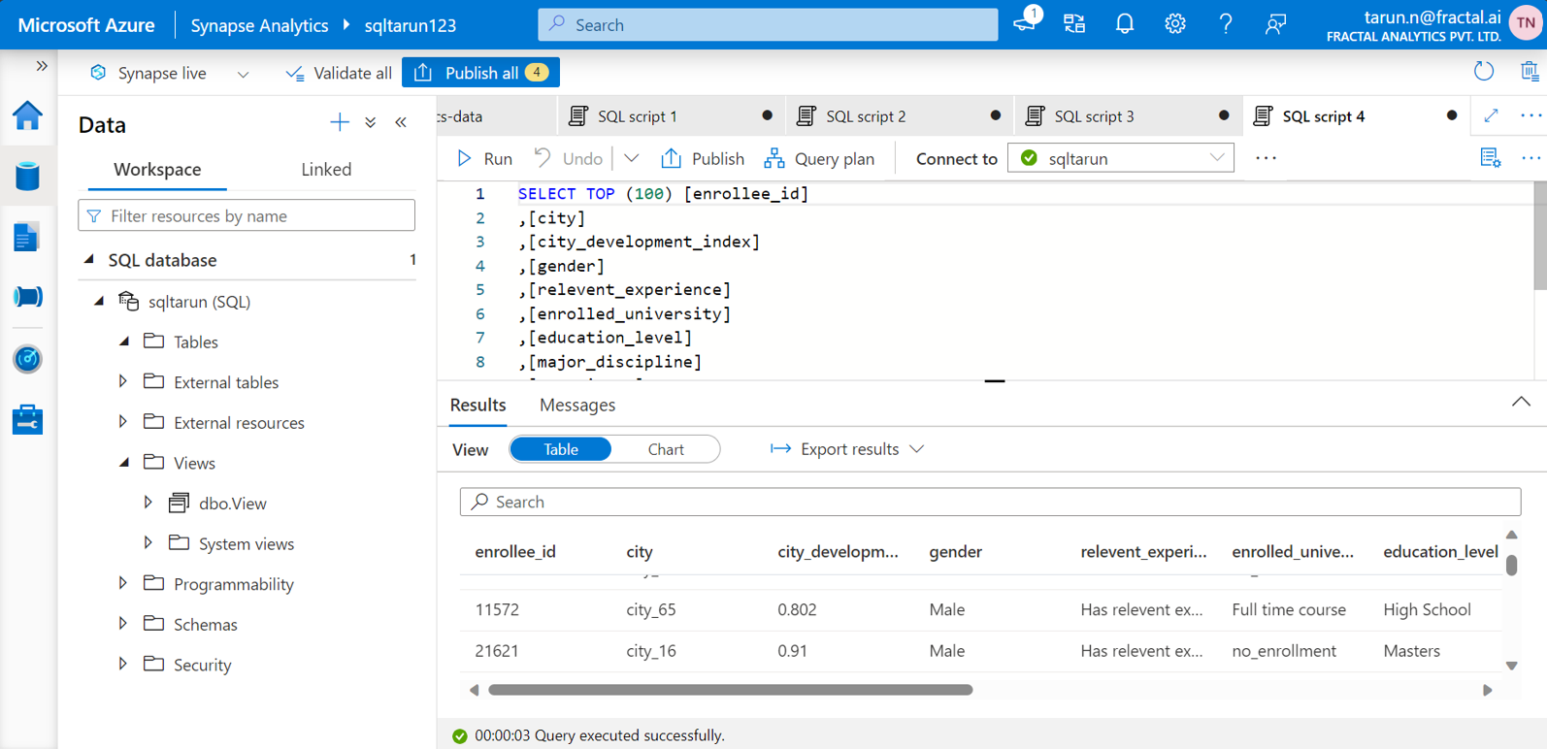
Analytics
Performing analysis using the SQL pool by creating a table called hranalytics.
Synapse view is used to read the contents of the data in the gold layer.
SQL pool is used to query the transformed data present in the gold layer in delta format. The generated view can be subsequently utilized by the analytics team for designing dashboards

Slide 40
Future works
Data analysis
Further data analysis can be done on the transformed data and valuable insights can be obtained.
Data visualization
The insights obtained from the transformed data can be projected using the dashboards for a clear understanding. This can be done using data visualization softwares such as Microsoft Power BI.
Machine learning algorithms
The transformed data can be used to train machine learning models by splitting into train and test data. It can be used to improve the predictability and accuracy of the model designed.

Slide 41

Resources provisioned for the capstone project
Throughout this capstone project,
I consistently managed resource provisioning and deprovisioning effectively, recognizing it as a fundamental responsibility of a data engineer

Slide 42
Thank You
Oct 2023

